Slide 1
TOURIST Competence centres for the development of sustainable tourism and innovative financial management strategies to increase the positive impact of local tourism in Thailand and Vietnam
Erasmus+ Capacity Building in Higher Education
Project Reference: 585785-EPP-1-2017-1-AT-EPPKA2-CBHE-JP
Duration: 36 Months (15/10/2017-14/10/2020)
Project Management: FH JOANNEUM

Slide 2
TOURIST 1st Training Hue/Vietnam An Introduction to Sustainable Tourism

Slide 3
Topic 3: Impacts of Tourism

Slide 4
Agenda for this morning
Tourism impacts (economic, environmental, socio-cultural)
Tools & methods: brainstorming, co-creation of theory, destination impact canvas, group work, discussions, cases

Slide 5
Learning Objectives

Slide 6
Learning Objectives of this Topic
Learning Objective 1: To create a common understanding of the different impacts of tourism, both pros and cons
Learning Objective 2: To apply the knowledge of the impacts of tourism in co-creation of the destination impact canvas
Learning Objective 3: To come to a common understanding of the most important impacts in the region

Slide 7
Topic 3 Tourism Impacts

Slide 8
PLANET
Environment
PROFIT
Economics
PEOPLE
Ethics

Slide 9
SUSTAINABLE TOURISM Balancing costs and benefits
Economic impact
Sustainable
tourism
Environmental impact
Socio-cultural impact

Slide 10
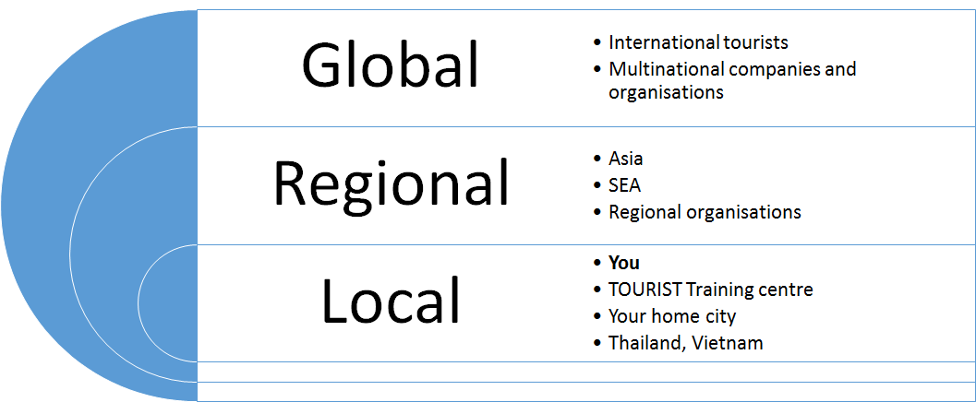

Slide 11
Group Exercise 1: Co-creation of the Destination Impact Canvas
In your group, discuss tourism impacts in your country
Environmental impacts
Economic impacts
Socio-cultural impacts
Both plusses and minuses, pros and cons
Write them down in your destination canvas
You have 15 minutes for this exercise.
Notes:
Annika! Miten käymme nämä läpi? Jos tulee vaikka 8 työtä, ei voida esittää kaikkia? Menee kamalasti aikaa ja kovin kyllästyttävää vähitellen. Olisiko niin, että tehdään molemmille maille yksi canvas, johon he käyvät kirjoittamassa nuo kolme tärkeintä? Ja vertaillaan, mitä vaikutukset ovat? Tässä mielenkiintoista maiden vertailu, mutta mutta, mistä nämä kaikki tulevatkaan, onko järkevää vertailla eli ovatko samantyyppisiä kohteita. Vai olisiko niin, että kaikki ajattelevat koko maata, jolloin voitaisiin katsoa, valitsevatko ryhmät samanlaisia vaikutuksia?

Slide 12
CHARACTERISTICS OF THE DESTINATION
Such as pull factors, services, attractions, activities required to know to understand the impacts
☺
☺
Impacts of travel and tourism in
____________________
ECONOMIC IMPACTS
ENVIRONMENTAL IMPACTS
☹
☹
☺
SOCIO-CULTURAL IMPACTS
☹

Slide 13
Group Exercise 1: Co-creation of Destination Impact Canvas
Choose the main impact – one only – in each category. Circle them.
You have 5 minutes for this.

Slide 14
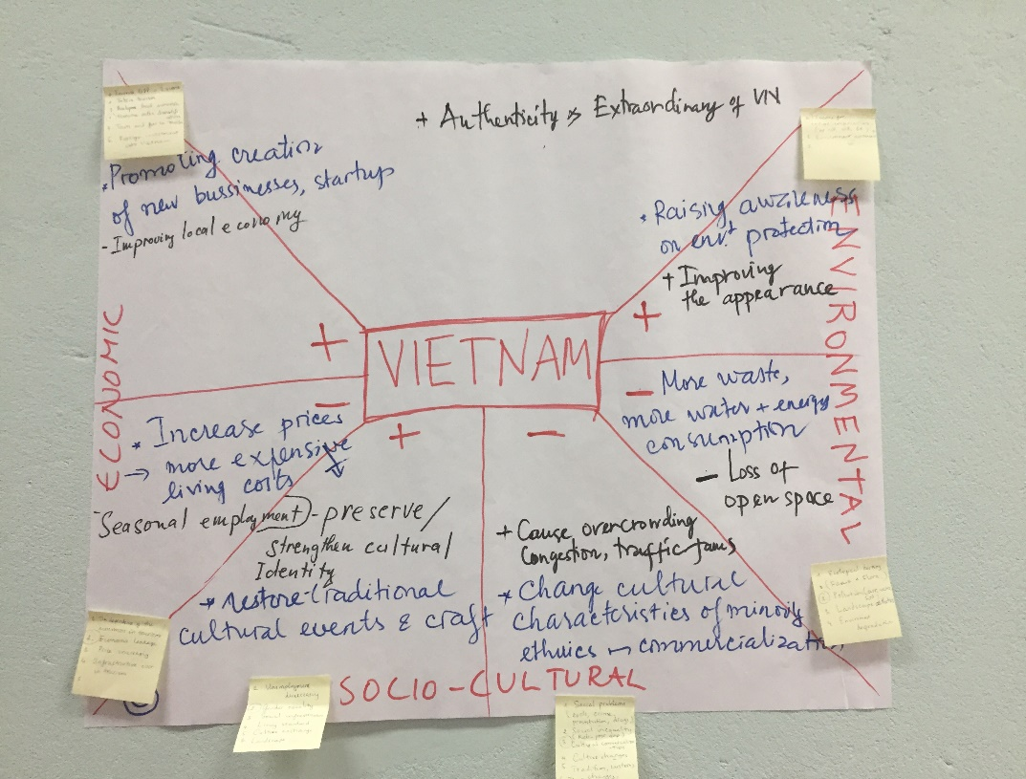
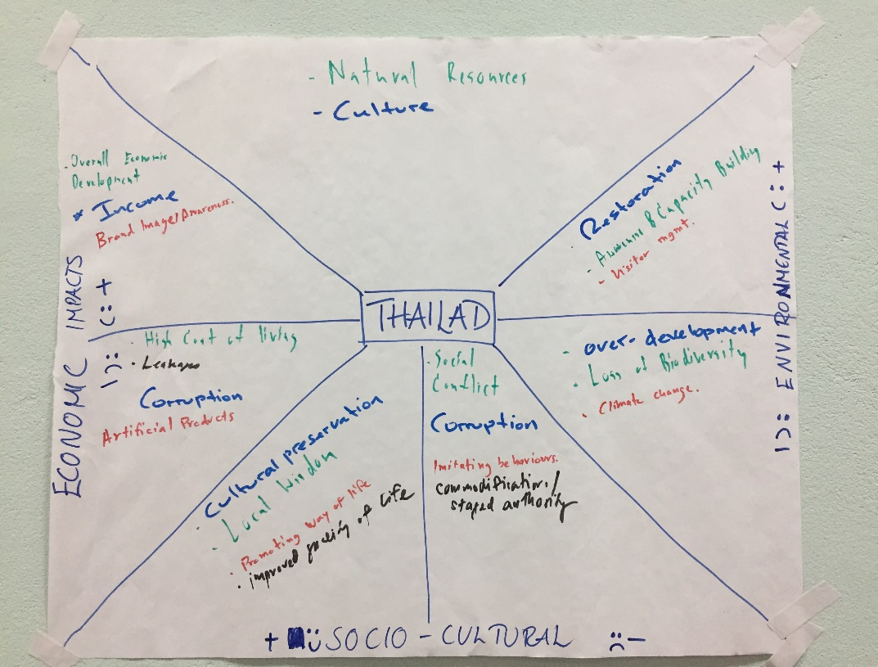
Group Exercise 1: Co-creation of Destination Impact Canvas
Every team writes the main impacts on the Canvas of Thailand / Canvas of Vietnam
You have 5 minutes for this.
Please present the country canvases to the rest of us

Slide 15
Economic impact
Economic benefits:
Income
Exports (30 % of world services exports; largest export category in many developing countries)
GDP (ca 10 % globally)
Diversification of local income
Investments
Employment (ca 10 % globally)
Regional development and increased standard of living
A growing industry (ca 4 % annual increase: 1.8 billion international tourists by 2030)
57 % of international tourist arrivals will be in emerging economies by 2030

Slide 16
Economic impact
Economic costs
Overdependence on tourism
Increased cost of living (price rises: labour, goods, taxes, land, rents)
Increased imports
Seasonality of income and employment
Economic exploitation: Low-pay and low-class jobs
Increased outside labour and ownership
Cost of training, administration and promotion

Slide 17
Environmental Impact
Environmental benefits
Awareness of the importance of conservation and biodiversity​
Establishment of wildlife / forest reserves and national parks​
Protecting the environment from more damaging forms of development (e.g. logging, dynamite fishing or mining) or destructive human activity (poaching)​
Financing for conservation​
Rehabilitation and preservation of historic sites​
Improvement of infrastructure​
Notes:
Paikallinen, alueellinen, globaali taso tähän?! Kuvio Handbookista s. 51: Important tourism regions facing biodiversity threat ?

Slide 18
Environmental Impact
Environmental costs ​
Land use and change: construction of buildings, airports ​
Loss of biodiversity (flora and fauna species extinction) and natural beauty ​
Direct: Hunting, land use, sale of souvenirs (shells, corals) and endangered species ​
Indirect: Emissions, climate change (5 % of global CO2 emissions) ​
Aesthetic and physical pollution: land use, infrastructure, loss of "views" and local character, visual pollution (littering, graffiti etc), "ribbon development", "tragedy of the commons"
Improper waste management: Beach and offshore water contamination
Energy consumption
Water consumption (Use of fresh water: international tourist uses 300 l per day; golf courses…) ​
Traffic congestion and noise ​
High seasonal population densities
Notes:
Paikallinen, alueellinen, globaali taso tähän?! Kuvio Handbookista s. 51: Important tourism regions facing biodiversity threat ?

Slide 19
Socio-cultural Impact
Socio-cultural benefits ​
Contributing to the maintenance of local attractions (museums, churches, theatres..)​
Regenerating awareness and pride in local culture and traditions, also food
Revitalisation of traditional activities and customs, arts and crafts
Increased quality of life and wellbeing (health, security, human rights, equality, sense of community, viability of services)
Exposure to new lifestyles and understanding of different cultures --> Contribution to the world peace, inter-cultural understanding, greater tolerance of different values and customs, building bridges between visitors and hosts

Slide 20
Socio-cultural Impact
Socio-cultural costs
Loss of traditional knowledge, rights, privacy
Segregation of local residents (hotel complexes, enclaves and “tourist ghettos”; national parks)
Too many visitors at peak periods: disenchantment, alienation of locals
Social exploitation: working conditions, low pay, child labour, human trafficking
Crime and other social problems
Commercialisation of contacts between locals and tourists
Culture clashes and increased resentment towards tourists (ill will, stereotypes, neo-colonialism; “zoo syndrome” photography)
Influence of different habits and behaviour, lack of understanding of local cultural traditions
Causing change in local cultural traditions (staged authenticity) > local culture is in danger of becoming commercialised and trivialised
Danger of loss of cultural treasures and degradation of local products > fake-art, cheap imitations, ”airport art”
Increased influence of Western culture around the world
Exploitation of indigenous populations

Slide 21
Socio-cultural Impact challenges...
Relationships are transitory and superficial
Under constraints of time and space, with visitors compacting sights in to as limited amount of time possible
Social impacts are area-specific and often hard to spot as they tend to occur slowly and are mostly intangible
Lack of spontaneity in relationships (organised, financial transactions)
Relationships are unequal and unbalanced, due to disparities in the wealth and status of the participants

Slide 22
Cases / Further Reading
Overtourism (e.g. Barcelona, Venice, Dubrovnik, Berlin, Amsterdam, Bali, Boracay, Nha Trang...)​
https://www.theguardian.com/commentisfree/2017/aug/11/tourism-tipping-point-travel-less-damage-destruction?CMP=share_btn_tw
https://www.nytimes.com/2018/04/04/world/asia/boracay-philippines-tourists-closed.html
https://www.theguardian.com/film/2018/mar/28/thailand-beach-leonardo-dicaprio-closing
http://www.ttrweekly.com/site/2018/03/nha-trang-invaded-by-chinese-tourists/comment-page-1/#comments

Slide 23
Cases / Further Reading
Social and economic issues (sharing economy / "live like a local" attitude, sex tourism)​
https://www.tourismconcern.org.uk/should-i-use-airbnb/?utm_source=twitter&utm_medium=social&utm_campaign=SocialWarfare
https://www.theguardian.com/commentisfree/2018/aug/31/airbnb-sharing-economy-cities-barcelona-inequality-locals
https://theconversation.com/your-choice-of-holiday-destination-is-a-political-act-100846
https://asiancorrespondent.com/2018/01/sex-tourism-pattaya-party/
Environmental issues (plastic pollution, elephant tours, polluted cities, fast development)
https://www.bangkokpost.com/news/special-reports/1514214/greening-thai-tourism
https://www.theguardian.com/travel/2018/aug/11/how-ethical-is-the-elephant-sanctuary-youre-visiting
https://www.theatlantic.com/science/archive/2016/05/elephants-tourism-thailand/483138/
https://skift.com/2017/03/10/beijing-still-has-a-massive-pollution-problem-for-tourists-and-locals-alike/
https://www.theguardian.com/world/2015/aug/01/vietnam-tourism-rush-development-conservation
Etc. You can find current cases from the news

Slide 24
Group exercise 2: How to tackle overtourism in your training
Pick a number
Find other members of your number team

Slide 25
Group exercise 2: How to tackle overtourism in your training
You have 90 minutes time for this topic in your training
Plan your method for the training
What contents and methods would you emphasise and why

Slide 26
Group exercise 2: How to tackle overtourism in your training
Please present your chosen method to the rest of us
Give feedback to each other!

Slide 27
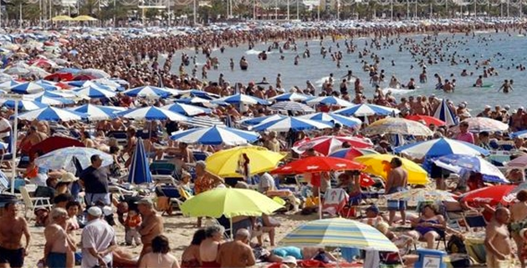
Suggested methods for studying overtourism cases
Articles printed on walls or read online
Read one article / two articles / or more
Discuss in small groups: What thoughts did the article(s) bring up?
Peer learning outcome can be shared as a discussion or – if deeper analysis is needed – notes on post-its and collect them on a flipchart.
This exercise will take 30 minutes or more depending on the depth of discussion.

Slide 28
Additional Reading Materials and Videos

Slide 29
Additional Reading Materials and Videos
Goodwin, H. 2017. The Challenge of Overtourism: http://haroldgoodwin.info/pubs/RTP%27WP4Overtourism01%272017.pdf
UNWTO: "Overtourism"? - Understanding and Managing Urban Tourism Growth beyond Perceptions: https://www.e-unwto.org/doi/pdf/10.18111/9789284420070
Video: Crowded Out – The Story of Overtourism: https://www.youtube.com/watch?v=U-52L7hYQiE
Video: Gringo Trails trailer: https://vimeo.com/71764610
Video: The Venice Syndrome trailer: https://vimeo.com/52491214
Video: Bye Bye Barcelona: https://www.youtube.com/watch?v=kdXcFChRpmI

Slide 30
Bibliography
GSTC: https://www.gstcouncil.org/
GSTC Destination Criteria: https://www.gstcouncil.org/gstc-criteria/gstc-destination-criteria/
Holloway, J Christopher, Humphreys, C. & Davison, R. 2016 The business of tourism.
Skift: Proposing solutions to overtourism: https://skift.com/2017/10/23/proposing-solutions-to-overtourism-in-popular-destinations-a-skift-framework/
Tourism Concern: https://www.tourismconcern.org.uk/
United Nations Sustainable Development Goals (SDGs): https://sustainabledevelopment.un.org/sdgs
UNWTO: http://www2.unwto.org/
Code of Ethics: http://ethics.unwto.org/en/content/global-code-ethics-tourism
Tourism4SDGs: http://tourism4sdgs.org/
Tourism and the Sustainable Development Goals – Journey to 2030: https://www.e-unwto.org/doi/pdf/10.18111/9789284419401
WEF: https://www.weforum.org/
The Travel and Tourism Competitiveness Report: https://www.weforum.org/reports/the-travel-tourism-competitiveness-report-2017
WTTC: https://www.wttc.org/
Economic Impact: https://www.wttc.org/economic-impact/

Slide 31
TOURIST Competence centres for the development of sustainable tourism and innovative financial management strategies to increase the positive impact of local tourism in Thailand and Vietnam
Erasmus+ Capacity Building in Higher Education
Project Reference: 585785-EPP-1-2017-1-AT-EPPKA2-CBHE-JP
Duration: 36 Months (15/10/2017-14/10/2020)
Project Management: FH JOANNEUM

